Slide 2
UNDERSTANDING COMPLEX JIT CASES
Behind the scenes of a
cross-border investigation
Notes:
[Good morning / afternoon!] My name is XX…
You may have encountered a joint investigation team before; possibly set some up already or participated in them. JITs are an amazing tool for cross-border investigations, making the gathering and sharing of evidence and information possible among authorities from various countries.
Today, we want to show you how effective a JIT can be by walking though an investigation of a real investment fraud case.
At certain times in the case, you will be asked on what you think is the best next step to take.

Slide 4
INTRODUCTION
Investment fraud is a complex crime to investigate
Cross-border criminality can make the investigations even more difficult for police and judiciary
We will look at an example of such an investigation where a JIT was used
The story begins in early 2021, with a legitimate-looking website that offers a very tempting investment opportunity…
Notes:
Investment fraud is a complex crime to investigate.
The cross-border dimension of the case makes the work of police and judiciary even more difficult.
We will look at how a JIT was used to support and facilitate the complex investigation.
The story begins in early 2021 with a legitimate looking website offering a very tempting investment opportunity

Slide 6
REVIEWING THE CASE
THE INVESTIGATIONS
 | Finnish investigation STATUS: ACTIVE
Website / Activity | BetterInvestments.com Share investments
Location | Registered: Florida, USA Hosted: Netherlands
Money Trail | Dedicated accounts in Finland, Sweden, France and the UK
Losses | 3 million EUR
Notes:
The video showed some facts of the case established by Inspector Mattis in a Finnish investigation of the Better Investments website.
Mattis discovered that Better Investments has several dedicated accounts not just in Finland but also in France, Sweden and the United Kingdom.
He also found out that the money that was paid to the Finnish account was transferred to accounts in Hong Kong, Taiwan and Ukraine.
We also heard how the links with French investigations were discovered.

Slide 7
REVIEWING THE CASE
THE INVESTIGATIONS
 | Finnish investigation STATUS: ACTIVE | French investigation STATUS: ACTIVE
Website / Activity | BetterInvestments.com Share investments | SecureInvestments.com Crypto investments
Location | Registered: Florida, USA Hosted: Netherlands | Ukraine???
Money Trail | Dedicated accounts in Finland, Sweden, France and the UK | Europol identified links with a Ukrainian account, French police investigating the same Finnish account
Losses | 3 million EUR | 5 million EUR
Notes:
When Mattis shared the information about the Better Investments website and the used accounts with Europol, a match with a French investigation was identified.
The same Ukrainian account that Better Investments is using is also under investigation in France.
When Mattis got in contact with the French police they informed him that the Ukrainian account is linked to a website named Secure Investments that is being investigated in France for a huge investment fraud.
It was established that Secure Investments also used the same Finnish account as Better Investments and Mattis widened his research to police reports related to Secure Investments (15 reports were found in Finland).

Slide 8
REVIEWING THE CASE
THE MONEY TRAIL
Notes:
Let’s take a look at the money trail:
In Finland victims of Better Investments deposited funds to accounts in Finland, France, the United Kingdom and Sweden, then the money was transferred to offshore accounts in Ukraine, Hong Kong, and Taiwan.
In France victims of Secure Investments deposited money to the accounts in Finland and France, which is later transferred to Ukraine.

Slide 9
BUILDING UP INTERNATIONAL COOPERATION
Multi-national dimension
Criminality likely ongoing
Complexity of the case
High number of victims
Notes:
Mattis concluded that as the two websites were still operational, criminal activity was probably still ongoing and has multinational dimension with high number of victims already identified.
Mattis understood that there is a need for more extensive police and judicial international cooperation in this case and he thought that establishing a JIT could be considered.

Slide 10
BUILDING UP INTERNATIONAL COOPERATION
FEBRUARY 2021
Notes:
Salla, an experienced prosecutor was appointed to the case.
She was briefed by Mattis about the scale and complexity of the investigation.
At that moment neither the trail of the proceeds of crime nor the location of the organised criminal group could be identified.
Mattis also talked to Salla about an idea of establishing a JIT, due to the established links and complexity of the case.

Slide 11
BUILDING UP INTERNATIONAL COOPERATION
FIRST STEPS
European Investigation Orders to
FRANCE
NETHERLANDS
SWEDEN
Requests for Mutual Legal Assistance to
UNITED KINGDOM
UKRAINE
UNITED STATES
HONG KONG
TAIWAN
Notes:
As a first step, based on data provided by Mattis, Salla drafted and transmitted:
European Investigation Orders to France, the Netherlands and Sweden and
requests for Mutual Legal Assistance to the United Kingdom, Ukraine, the United States of America, Hong Kong and Taiwan.
She was requesting information on the involved websites, used bank accounts and financial transactions.

Slide 12
BUILDING UP INTERNATIONAL COOPERATION
FIRST STEPS
The MLAs and EIOs have been sent, but…
How can Finland engage with other countries as efficiently as possible?
How could the criminal activities be stopped without destroying the evidence and the possibility of arrests?
Where do the criminals operate?
What’s next?
Notes:
Salla was thinking what to do next, how to engage as efficiently as possible with other countries and find answers to the open questions in the investigation.
Here we have our first question - what do you think that Salla should do next to facilitate the investigation?

Slide 14
QUESTION 1

Slide 15
What should Salla do next?
A
Wait for the EIOs/MLAs to be executed without any further steps
B
Contact Eurojust National Desk to discuss the organisation of a coordination meeting with the involved countries
C
Contact Finnish JIT National Expert to discuss setting up a JIT
D
Advise Mattis to continue working with the Finnish Europol Liaison Bureau and to provide them with as much information as required for database-driven analyses
E
Agree with Mattis to request an operational meeting at Europol
Notes:
What should Salla do next?
Wait for the EIOs/MLAs to be executed without any further steps
Contact the Eurojust National Desk to discuss the organisation of a coordination meeting with the involved countries
Contact the Finnish JIT National Expert to discuss setting up a JIT
Advise Mattis to continue working with the Finnish Europol Liaison Bureau and to provide them with as much information as required for database-driven analyses
Agree with Mattis to request an operational meeting at Europol
More than one answer can be correct.

Slide 16
What should Salla do next?
A
Wait for the EIOs/MLAs to be executed without any further steps
B
Contact Eurojust National Desk to discuss the organisation of a coordination meeting with the involved countries
C
Contact Finnish JIT National Expert to discuss setting up a JIT
D
Advise Mattis to continue working with the Finnish Europol Liaison Bureau and to provide them with as much information as required for database-driven analyses
E
Agree with Mattis to request an operational meeting at Europol
Notes:
Answer A is not right – there is plenty that can be done to make the investigation go further.
All other steps could be taken in the meanwhile. Let’s see how this went in our case!

Slide 17
SALLA CONTACTS THE FINNISH JIT NATIONAL EXPERT
Notes:
As a first step Salla contacted the Finnish JIT National Expert

Slide 18
THE JIT NATIONAL EXPERT’S RECOMMENDATIONS
Salla should:
Approach the Finnish National Desk at Eurojust and request to Begin contact with French and Ukrainian colleagues
about the possibility of organising a Coordination Meeting to discuss setting up a JIT
Mattis should:
Continue working with the Finnish Europol Liaison Bureau
Provide them with as much information as possible to enable them to conduct analyses using their databases
Request operational meeting at Europol
Notes:
The expert recommended that
Salla should approach Finnish National Desk at Eurojust to engage with French and Ukrainian colleagues about the possibility of organising coordination meeting and possibly set up a JIT
Mattis should continue working with the Liaison Bureau at Europol, share information via SIENA and request an operational meeting

Slide 19
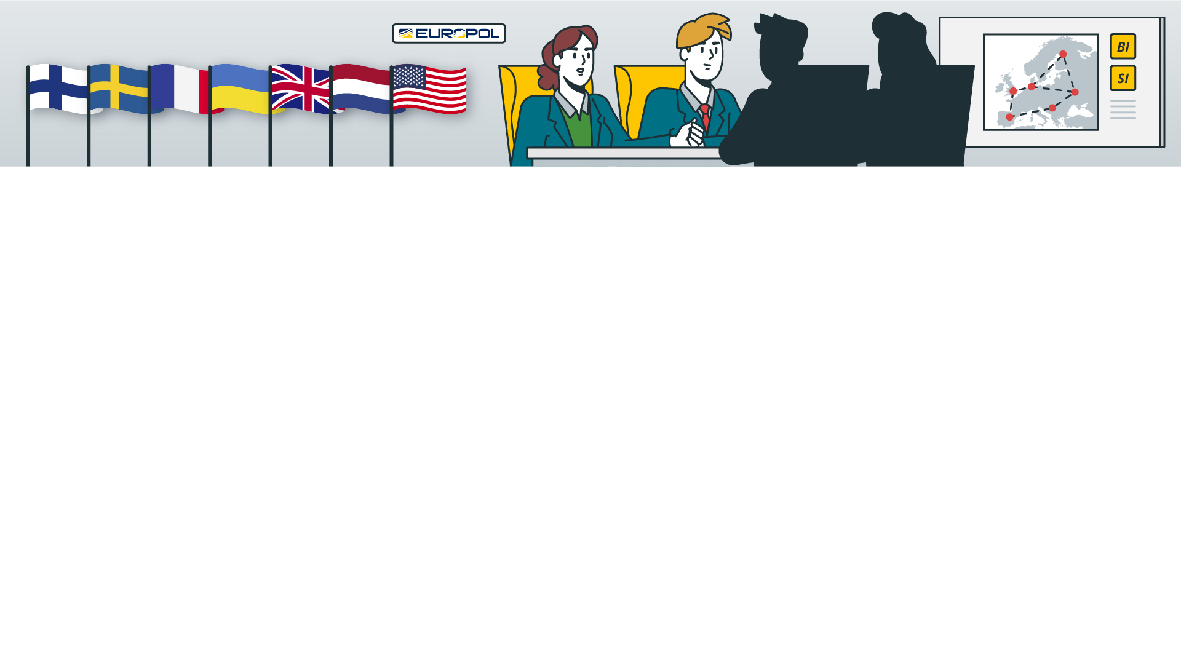
OPERATIONAL MEETING AT EUROPOL
APRIL 2021
Identify the modus operandi of the organised crime group
Identify the individuals involved
Locate the proceeds of the crimes
PRESENT
Police officers from FINLAND FRANCE SWEDEN UKRAINE UNITED KINGDOM NETHERLANDS UNITED STATES
Notes:
After discussing with Salla, Mattis indeed requested an operational meeting at Europol to which police officers from Finland, France, Sweden, Ukraine, United Kingdom, the Netherlands, and the United States were invited.
The aim of the meeting was to:
Identify the working methods of the OCG
Identify key suspects behind the scam websites.
Tracing stolen funds across multiple countries.

Slide 20
CONTACT WITH NATIONAL DESK AT EUROJUST
APRIL 2021
Explore the links identified between Finnish and French investigations
Understand how to cooperate with third countries involved
Discuss organising a coordination meeting – and who to invite
Notes:
At the same time, Salla contacted the Finnish National Desk at Eurojust to ask help with
exploring links between the Finnish and French investigations
understanding how to cooperate with third countries (non-EU countries) involved
non-EU Member states may also be members of a JIT
Ukraine has a Liaison Prosecutor posted at Eurojust
And to request a coordination meeting and discuss who to invite

Slide 21
PLANNING A COORDINATION MEETING – WHO TO INVITE?
APRIL 2021: LEVEL 2 MEETING AT EUROJUST
United Kingdom and Germany: see if they could find or trigger investigations in these countries too, as a lot of money had been sent there
Sweden: lot of money had been paid directly into Swedish bank accounts by the victims
Europol: Analysis Project Sustrans and Apate and European Cybercrime Centre representatives
JITs Network Secretariat: JITs and JITs funding programme
Notes:
The Finnish National Member listened to Salla and her questions and based on this, organised a level 2 meeting at Eurojust. Colleagues from France and Ukraine were invited.
They agreed to organise a coordination meeting and discussed who to invite.
The French prosecutor suggested inviting representatives not only from Ukraine but also from the United Kingdom and Germany. They discovered that a lot of money had been sent to these countries. The aim would be to see if they could find or trigger investigations in these countries too, as money laundering would be better investigated nationally.
Salla suggested inviting representatives from Sweden, as in Finland they had found that quite a lot of money had been paid directly into Swedish bank accounts by the victims.
They also agreed that the national liaison officers at Europol from the countries involved and representatives from the Europol Analysis Project Sustrans and Apate and from the European Cybercrime Centre should also be invited.
As Salla expressed interest in discussing setting up a JIT between involved countries to facilitate cooperation, it was agreed to invite also JITs Network Secretariat to present advantages of JITs, in particular financial support offered by Eurojust

Slide 22
Notes:
After all this planning, the coordination meeting took place at Eurojust in May 2021.

Slide 23
COORDINATION MEETING AT EUROJUST
MAY 2021
To explore links between Finnish and French investigations
To discuss opening investigations in other countries involved
Discuss the idea of establishing a JIT
PRESENT
FRANCE UKRAINE UNITED KINGDOM GERMANY SWEDEN EUROPOL JNS
Notes:
The aim of the meeting was to:
To explore links between Finnish and French investigations
To discuss opening investigations in other countries involved
Discuss the idea of establishing a JIT
During the meeting the need for close cooperation between Finland and France was identified. They agreed to set up a JIT for a duration of one year.

Slide 24
COORDINATION MEETING AT EUROJUST
OUTCOMES
Setting up a JIT between Finland and France was agreed
Sweden agreed to swiftly start an investigation into the money laundering activities
United Kingdom, Germany and Ukraine decided not to open investigations for now
All agreed to swiftly execute previously sent EIOs and MLA requests
All agreed to voluntarily share as much information as possible based on Article 7 of the 2000 EU MLA Convention
Costs of cross-border cooperation were discussed
Notes:
At the same time, based on the information received, representatives from Sweden agreed to swiftly start an investigation into the money laundering activities.
Representatives from the United Kingdom, Germany and Ukraine decided not to open an investigation at this stage.
However, all agreed to support the investigations by taking the information received to their respective colleagues for further assessment.
All countries agreed to swiftly execute EIOs and MLA requests and voluntarily share as much information as possible based on Article 7 of the 2000 EU MLA Convention.
Furthermore costs of intensive cross border cooperation were discussed, in particular in JITs, and the parties wondered what to do?

Slide 26
QUESTION 2

Slide 27
Cross-border cooperation is expensive.
How can JIT parties finance the costs?
A
Decide not to cooperate due to significant costs
B
Apply for JIT funding provided by Eurojust
C
If not done yet, explore funding options provided by Europol
D
Send a request to the European Commission
Notes:
JIT parties have some choices to make on how to finance their actions. They could consider:
Not to cooperate due to significant costs
Apply for JIT funding provided by Eurojust
Explore funding options provided by Europol
Send a request to the European Commission

Slide 28
Cross-border cooperation is expensive.
How can JIT parties finance the costs?
A
Decide not to cooperate due to significant costs
B
Apply for JIT funding provided by Eurojust
C
Explore funding options provided by Europol
D
Send a request to the European Commission
Notes:
JIT funding is available from Eurojust; Europol has further funding opportunities. Therefore leaving a case unsolved should not be the case – cooperation may be expensive but there is help!
As there are dedicated funding opportunities at Eurojust and Europol, funding from the Commission is not necessary.
In this case the Finnish police volunteered to took responsibility for applying for JIT funding provided by Eurojust.

Slide 29
JIT AGREEMENT
Notes:
The next important step was drafting the JIT agreement:
This is a legal framework that allows two or more countries to work together on a specific criminal investigation and exchange information and evidence directly without relying on traditional methods of mutual legal assistance.

Slide 30
JIT AGREEMENT
DRAFTING and NEGOTIATIONS
Drafted by the Finnish National Desk at Eurojust
Negotiated with the support of the National Desks involved
Notes:
How did it go in our case: the JIT agreement was rapidly drafted by Finnish Desk at Eurojust and then negotiated with the support of the National Desks involved.
JIT agreements can be signed if an applicable legal basis exists.
Do you know what is the applicable legal basis to sign a JIT between Finland and France?

Slide 32
QUESTION 3

Slide 33
Which legal basis applies for the setting up
of the JIT between Finland and France?
A
Art. 13 of the 2000 EU Convention on Mutual Legal Assistance (MLA 2000)
B
Art. 19 of the UN Convention Against Transnational Organised Crime
C
Art. 20 of the Second Additional Protocol to the
1959 European Convention on Mutual Assistance in Criminal Matters
D
2002/465/JHA Framework Decision on Joint Investigation Teams
Notes:
Which legal basis applies for the setting up a JIT between Finland and France?
Article 13 of the 2000 EU Convention on Mutual Legal Assistance (MLA 2000)
Article 19 of the UN Convention Against Transnational Organised Crime
Article. 20 of the Second Additional Protocol to the 1959 European Convention on Mutual Assistance in Criminal Matters
2002/465/JHA Framework Decision on Joint Investigation Teams

Slide 34
Which legal basis applies for the setting up
of the JIT between Finland and France?
A
Art. 13 of the 2000 EU Convention on Mutual Legal Assistance (MLA 2000)
B
Art. 19 of the UN Convention Against Transnational Organised Crime
C
Art. 20 of the Second Additional Protocol to the
1959 European Convention on Mutual Assistance in Criminal Matters
D
2002/465/JHA Framework Decision on Joint Investigation Teams
Notes:
As both countries are EU Member States both Article 13 of the MLA Convention 2000 and the 2002/465/JHA Framework Decision on Joint Investigation Teams is a good possibility: they provide an extensive set of rules for setting up a JIT.
The other two legal bases on the slide work better if there is a country involved that is not a member of the EU.

Slide 35
JIT AGREEMENT
SIGNATURE
JIT agreement signed by Finland and France
Came into force before the end of May 2021
Eurojust and Europol subsequently also signed the appendix to the JIT agreement and became participants in the JIT
JIT funding application was submitted by Finnish JIT member on behalf of the JIT
Notes:
The JIT agreement was signed by the relevant authorities and came into force before the end of May 2021.
Eurojust and Europol subsequently also signed the appendix to the JIT agreement and became participants in the JIT.
Once the agreement was signed, it was possible to submit a JIT funding application, which was done by the Finnish authorities

Slide 37
JIT: OPERATIONAL MEETING IN FRANCE
Finnish delegation led by Mattis and Salla travelled to France for an in-depth work meeting with their French JIT partners.
Meeting forged a working relationship between the JIT partners and provided more in-depth information on, and understanding of, the crimes committed
Notes:
Shortly after the JIT agreement was signed, a Finnish delegation led by Mattis and Salla travelled to France
They had an in-depth work meeting with their French JIT counterparts.
The meeting forged a good working relationship between the JIT partners and provided in-depth information on the crimes, with better understanding for all.
The ice was broken and Finnish–French cooperation went very smoothly after this.

Slide 38
SECOND COORDINATION MEETING AT EUROJUST
JULY 2021
Finland and France present updates on the state of play of their investigations
Sweden, Germany and Ukraine report that they also opened their own investigations and present their first findings
Europol participates in the coordination meeting and presents the results of its analyses
PRESENT
FINLAND FRANCE UKRAINE UNITED KINGDOM GERMANY SWEDEN EUROPOL
Notes:
Two months later JIT parties proposed to organise a coordination meeting at Eurojust to share their updates and hear about the progress in other involved countries.
Finland and France presented their updates on the state of play of their investigations.
At this meeting Sweden, Germany and Ukraine reported that they had also opened their own investigations and presented their first findings.
Europol participated in the coordination meeting and presented the results of its analyses.
While the United Kingdom didn’t open an investigation, they participated at the meetings still.

Slide 39
SECOND COORDINATION MEETING
OUTCOMES
Swedish and German investigations focused on money laundering: suspects residing in both Member States have been receiving and forwarding on large amounts of money to Ukraine, Turkey and Hong Kong
Agreement to extend JIT to include Germany and Sweden
In Ukraine, the crimes investigated were gross fraud; a call centre using young employees to sell valueless shares had been identified in Kyiv
Ukraine would also have liked to join the JIT, but as the investigation was at a very early stage this was not yet possible
Notes:
Both the Swedish and German investigations focused on money laundering: a number of suspects residing in both Member States had been receiving and forwarding large amounts of money to Ukraine, Turkey and Hong Kong.
It was agreed to extend the JIT to include Germany and Sweden.
In Ukraine, the crimes investigated were gross fraud, and a call centre using young employees to sell valueless shares had been identified in Kyiv. Ukraine would also have liked to join the JIT, but as the investigation was at a very early stage this was not yet possible.
The JIT will therefore expand to Germany and Sweden at this stage. When new countries join, what needs to be done?

Slide 41
QUESTION 4

Slide 42
Sweden and Germany would like to join the JIT.
What needs to be done?
A
An amendment to the JIT agreement including Sweden
and Germany as parties needs to be signed
B
An amendment to the JIT agreement including
Sweden, Germany and Ukraine needs to be signed
C
A notice should be provided informing the JIT parties
that Sweden and Germany would like to join the JIT
D
A new JIT agreement would need to be drafted
Notes:
Two additional EU countries are joining the JIT. What is the way to make this happen?
An amendment to the JIT agreement including Sweden and Germany as parties needs to be signed
An amendment to the JIT agreement including Sweden, Germany and Ukraine needs to be signed
A notice should be provided informing the JIT parties that Sweden and Germany would like to join the JIT
A new JIT agreement would need to be drafted

Slide 43
Sweden and Germany would like to join the JIT.
What needs to be done?
A
An amendment to the JIT agreement including Sweden
and Germany as parties needs to be signed
B
An amendment to the JIT agreement including
Sweden, Germany and Ukraine needs to be signed
C
A notice should be provided informing the JIT parties
that Sweden and Germany would like to join the JIT
D
A new JIT agreement would need to be drafted
Notes:
The JIT agreement needs to be amended to include Sweden and Germany as parties to the JIT.
In our case, the Eurojust National Desks once again provided their support by drafting an amendment to the JIT agreement and taking this through the negotiation and signing processes.

Slide 44
JIT: DEVELOPMENTS
SEPTEMBER 2021
Ukraine formally joins
the JIT in September 2021
Several meetings: physically
in their respective countries
or by videoconference
Exchange of information and evidence
takes place in secure manner
(operational meetings, SIENA)
AUGUST
2021
DECEMBER
2021
Notes:
During the autumn of 2021, police and prosecutors from JIT parties met several times, either physically or by videoconference, to exchange information.
As not all participants were able to speak a common language, Eurojust was asked to organise coordination meetings with simultaneous interpretation.
Evidence was securely shared mainly during these meetings. However, occasionally Europol’s SIENA tool was used to transfer the evidence.
With the support of the Ukrainian Liaison Prosecutor posted at Eurojust, joint cooperation efforts also took place in Ukraine on a couple of occasions, and in September Ukraine also formally joined the JIT. The JIT agreement was amended again to include Ukraine as a party.
What was the legal basis for this?

Slide 46
QUESTION 5

Slide 47
The JIT agreement has to be amended to include Ukraine.
Which legal basis should be added to the JIT agreement?
A
No need to change or add any legal basis
B
Art. 19 of the UN Convention against Transnational Organized Crime
C
Art. 20 of the Second Additional Protocol to the 1959 MLA Convention
D
Art. 49 of the UN Convention Against Corruption
E
Art. 12 of the Second Additional Protocol to the Convention on Cybercrime
Notes:
The JIT agreement has to be amended to include Ukraine. Which legal basis should be added to the JIT agreement?
No need to change or add any legal basis
Article 19 of the UN Convention against Transnational Organized Crime
Article 20 of the Second Additional Protocol to the 1959 MLA Convention
Article 49 of the UN Convention Against Corruption
Article 12 of the Second Additional Protocol to the Convention on Cybercrime

Slide 48
The JIT agreement has to be amended to include Ukraine.
Which legal basis should be added to the JIT agreement?
A
No need to change or add any legal basis
B
Art. 19 of the UN Convention against Transnational Organized Crime
C
Art. 20 of the Second Additional Protocol to the 1959 MLA Convention
D
Art. 49 of the UN Convention Against Corruption
E
Art. 12 of the Second Additional Protocol to the Convention on Cybercrime
Notes:
Article 20 of the Second Additional Protocol to the 1959 MLA Convention is the best option for this since all involved countries (France, Sweden, Germany and Ukraine) ratified this Convention ( common legal basis).
As before, Eurojust supported this extension to the JIT. This greatly facilitated exchange of information with Ukraine and eventually led to the identification of targets. Once targets were identified JIT parties could start preparations for an action day.

Slide 49
Notes:
The time for actions arrived!

Slide 50
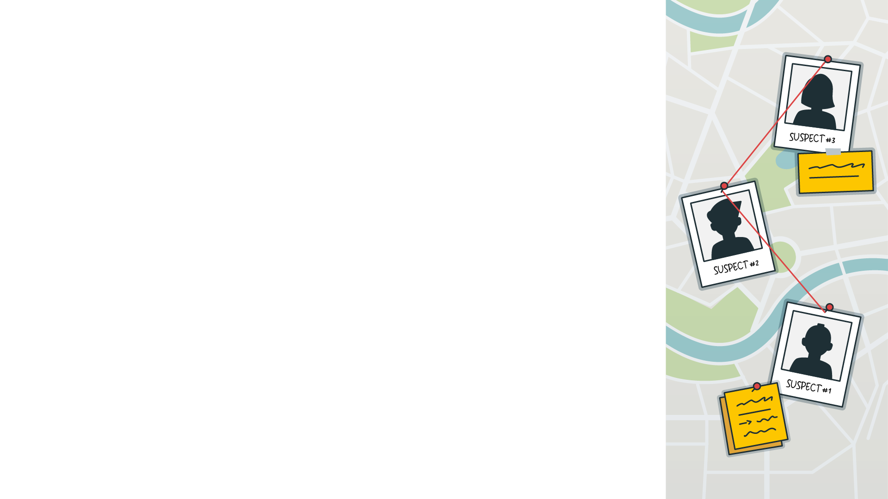
JIT: TIME FOR ACTIONS!
Targets identified: Coordination meeting at Eurojust to plan a Joint Action Day (December 2021)
Joint Action Day to take place on February 2022 in all the parties to the JIT
Coordinated activities in Hong Kong, Taiwan and the United Kingdom, which were not participating in the JIT
France reported that two of its suspects were now residing in Belgium and that European Arrest Warrants should be issued for them and executed during the Joint Action Day
Notes:
In December 2021 targets were identified and a coordination meeting took place at Eurojust to plan for a joint action day.
The action day was scheduled for the end of February 2022. Actions were planned to take place in the countries of all parties of the JIT, as well as in Hong Kong, Taiwan and United Kingdom.
France reported that two suspects were in Belgium and so an European Arrest Warrant will be issued to Belgium to execute it on the joint action day.
These are a lot of action planed in a lot of involved countries. What is the best way to coordinate them?

Slide 52
QUESTION 6

Slide 53
What Eurojust tool would be useful for JIT parties
to coordinate the planned actions?
A
Level II meeting
B
Another coordination meeting
C
JIT Network meeting
D
Coordination centre
E
No coordination tool needed
Notes:
What Eurojust tool would be useful for JIT parties to coordinate the planned actions?
Level II meeting
Another coordination meeting
JIT Network meeting
Coordination centre
No coordination tool is needed, modern communication technology is enough

Slide 54
What Eurojust tool would be useful for JIT parties
to coordinate the planned actions?
A
Level II meeting
B
Another coordination meeting
C
JIT Network meeting
D
Coordination centre
E
No coordination tool needed
Notes:
Coordination centres are a judicial tool created by Eurojust in support to action days against criminal organisations where arrests, searches, interviews of suspects and witnesses, seizures of evidence and freezing of assets are carried out in several countries at the same time.
Eurojust coordinates the efforts of the competent national authorities, continuously monitors the ongoing operations, assists with legal and practical advice and facilitates the issuing of critical judicial instruments, ensuring that the actions taken lead to successful prosecutions.
Key to success is the unique setting in which representatives of the National Desks and Liaison Prosecutors of the involved countries are supported by legal and technical experts.
Coordination centres are set up from a dedicated Eurojust room equipped with state-of-the-art technology and/or virtually via videoconference facilities, to ensure that evidence and information collected on the ground are swiftly exchanged amongst all involved national authorities in a secure environment.

Slide 55
JOINT ACTION DAY
FEBRUARY 2022
Large number of simultaneous house searches, arrests and seizures carried out within Finland, France, Germany, Sweden and Ukraine
Freezing orders and MLA requests for interviews executed in the United Kingdom, Taiwan and Hong Kong
Belgium executed two European Arrest Warrants from France
Notes:
As planned JAD was carried out in late February. Eurojust coordination centre facilitated execution of operational activities and the real time exchange of information. Europol also provided operational support.
A large number of house searches, arrests and seizures were carried out in Finland, France, Germany, Sweden and Ukraine.
In addition, freezing orders and MLA requests for interviews were executed in the United Kingdom, Taiwan and Hong Kong.
Belgium executed two European Arrest Warrants from France.
The Eurojust coordination centre facilitated the planning of the operational activities and the real-time exchange of information.
Europol also provided operational support.

Slide 56
JOINT ACTION DAY
RESULTS
41 people arrested
65 house searches
EUR 5 million frozen
Joint press release two days later made the overall results public
Notes:
By the close of the action day the preliminary results were already available thanks to data from the coordination centre.
The overall results were were made public in a joint press release two days later.
41 people were arrested,
65 house searches performed and
Five million euros frozen.

Slide 57
FURTHER DEVELOPMENTS
MAY 2022
JIT prolonged for another year
AUGUST 2022
Fourth coordination meeting
Results of analyses of material collected
Final agreements
Notes:
In May 2022 it was agreed that the JIT should be prolonged for another year and the National Desks ensured the swift extension of the JIT agreement.
A fourth coordination meeting was held in August 2022 where the detailed results were presented and parties had to agree how to carry out joint analyses of the material collected.
Several other important decisions needed to be made at this stage. What do you think it’s important that parties agree upon now that arrest took place and crucial evidence was gathered?

Slide 59
QUESTION 7

Slide 60
What final agreements should be discussed
during the coordination meeting?
A
Where best to prosecute each of the suspects,
including to avoid ne bis in idem issues
B
How to proceed with the confiscation of the seized proceeds of crime
C
How international cooperation should continue in the future
D
There are no further issues to discuss
Notes:
What final agreements should be discussed during the coordination meeting?
Where best to prosecute each of the suspects, including to avoid ne bis in idem issues
How to proceed with the confiscation of the seized proceeds of crime
How international cooperation should continue in the future
There are no further issues to discuss

Slide 61
What final agreements should be discussed
during the Coordination meeting?
A
Where best to prosecute each of the suspects,
including to avoid ne bis in idem issues
B
How to proceed with the confiscation of the seized proceeds of crime
C
How international cooperation should continue in the future
D
There are no further issues to discuss
Notes:
It was essential to discuss where to prosecute the suspects, including to avoid ne bis in idem issues.
An agreement was also reached on how to proceed with the confiscation of the seized proceeds of crime.
Participants also discussed how international cooperation should continue in the future.

Slide 62
CLOSURE AND TRIAL

Slide 63
JIT: CLOSURE AND TRIAL
2024
JIT active for 3 years
By this time, most of the investigations finalised, and trials in Sweden and Germany completed
Despite the JIT agreement expiring, parties continue to cooperate closely until the successful conclusion of all the cases
Notes:
The JIT work continued.
Because of the vast amount of information and evidence for analysis the JIT was extended for another year.
The JIT was active for a total of 3 years.
By this time, most of the investigations were finalized and trials in Sweden and Germany, where the smaller money laundering cases were investigated, had already been completed. The trials in Finland, France and Ukraine were at the final stages.
The JIT partners felt that, despite the JIT agreement expiring, they should continue to cooperate closely until the successful conclusion of all the cases.

Slide 64
COORDINATION MEETING – JIT EVALUATION
OUTCOMES
Each delegation gives a short presentation outlining the results of its cases and sharing the lessons learned
Salla and Mattis both attend and present the results from the trial at the Court of First Instance
Notes:
Soon after the JIT expired another coordination meeting was arranged, this time to evaluate the JIT. All countries explained about the results of cases and shared lessons learned
From Finland, Salla and Mattis both attended to talk about the results from a trial at the court of first instance.
Why is it important to do JIT evaluations?

Slide 66
QUESTION 8

Slide 67
What are the objectives of JIT evaluation meetings?
A
Share best practices and lessons learned
B
Collect information from JITs on how the cooperation can be further improved
C
Collect findings in view of drafting JIT evaluation reports
D
Request JITs funding
Notes:
What are the objectives of JIT evaluation meetings?
Share best practices and lessons learned
Collect information from JITs on how the cooperation can be further improved
Collect findings in view of drafting JIT evaluation reports
Request JITs funding

Slide 68
What are the objectives of evaluation meetings?
A
Share best practices and lessons learned
B
Collect information from JITs on how the cooperation can be further improved
C
Collect findings in view of drafting JIT evaluation reports
D
Request JITs funding
Notes:
JIT evaluations are about
Sharing best practices and lessons learned
Collecting information from JITs on how the cooperation can be further improved
Collecting material for JIT evaluation reports

Slide 69
FINANCIAL ASSISTANCE
JIT applied for Eurojust financial support on 10 occasions
Grants awarded to the JIT used to assist with travel and accommodation for JIT members, pay for interpretation costs during meetings, and translate the evidence exchanged
Notes:
The JIT was funded by Eurojust on ten separate occasions
Grants awarded to the JIT were used to assist with travel and accommodation for JIT members, pay for interpretation costs during meetings, and translate the evidence exchanged

Slide 70
RESULTS
Criminal activity
interrupted
Large number of suspects convicted or shortly going to trial
A considerable amount of money seized and forfeited or returned to the victims
Notes:
Overall, the JIT was a success: criminal activity was interrupted and a large number of suspects convicted. In addition, a considerable amount of money (more than expected) was seized and forfeited or returned to the victims.
Salla and Mattis underlined the excellent cooperation with all JIT parties without which they would not have been able to identify and obtain evidence against the key suspects and retrieve victims money. Without the JIT their Finnish case would never have succeeded.
Everyone expressed their appreciation for the mutual support provided and for the support provided by both Eurojust and Europol.
We wish you similar success in your own JIT investigations!

